Slide 1
What is History?
Write on your desk what you believe history is.
Next write what you think about history?
Notes:
I will do this as a warm up on day 1

Slide 3
Day 1 Warm Up
What do you expect of me as a teacher,
If you were the teacher, what would you expect of your students?
What does Coach Chavira need to do to help you be successful this year?
What class norms will help you learn?
Notes:
Day 2 Warm up

Slide 4
Day 3 Warm up
Begin with filling out your Texas history map on the back. Please put anything you know or remember about Texas in or around this map. You can draw pictures, write information, dates, etc.
When you are finished, on the left hand side outside the map, you will write down what you hope to learn in this class.
Notes:
Day 3 Warm up then will get into classroom expectation and norms after having a discussion about what they already know.

Slide 6
Draw two circle maps on your paper and put down what you think a Primary Source is and what a Secondary Source is
Primary
Source
Secondary Source
Notes:
I will do this on 4th day of school.

Slide 7
Goal: To understand the difference between primary and secondary sources. That will allow students to evaluate the validity of a source. 7.2G
How are we going to do this:
Define the terms
practice determining the difference between the two
Answer questions to show deep understanding of the
two terms.

Slide 8
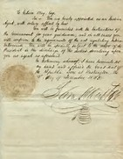
Pick a side: By the chalk board is Primary Source Front of room is Secondary Source Unsure is middle of the room

Slide 9
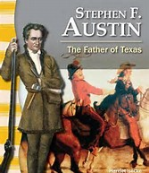

Slide 10
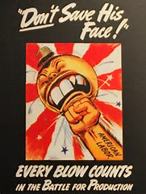
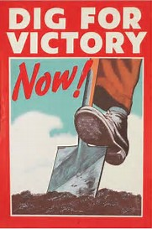

Slide 11
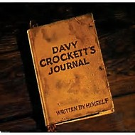
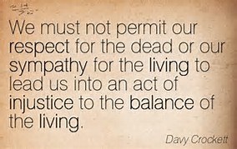

Slide 12
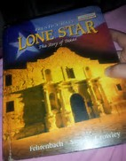

Slide 13
Move to the four Corners of the room to give your answer
Which of the following would not be a secondary source?
A. reproduction of musket balls sold to tourists
B. William Barrett Travis’ letter written during the siege of the
Alamo
C. textbook of Texas History
D. article in a modern scholarship journal about the Alamo.
Which of the following would not be a primary source used by historians?
A. coins used during the Texas Revolution
B. pieces of pottery unearthed at an architectural site
C. pictures from a modern artist of what he thinks Washington-on-the-Brazos looked like
D. diary written by William Barrett Travis

Slide 14
Back to your seat.
Which document would be considered a primary source? A. an encyclopedia article about Sam Houston B. chapter in a textbook about European exploration and colonization C. a recent biography of Stephen F. Austin D. speeches written by Frederick Douglass

Slide 15
Now use your resources to define what primary source is and what a secondary source is
Create a two four square on the back of your paper. Complete both using the words Primary and Secondary source
Textbook definition | Definition in your own words
Examples | Picture
Put Word in the middle

Slide 16
Using what you know about Primary and Secondary Source answer the following questions
1. What is the difference between a primary and secondary source?
2. Why is it important to use primary sources while studying history?
3. What types of primary sources are used by historians?

