Slide 1
Roots of the American Government

Slide 2
The Magna Carta 1215
The English people forced King John to sign the Magna Carta in 1215, which is the first time that a King gave up any power to the people. This document said that the king could not raise taxes without first consulting the Great Council later become known as English Parliament (legislative branch). He also agreed that nobles and freeman should not be punished without a trial by jury.
First time of limited government was created

Slide 3
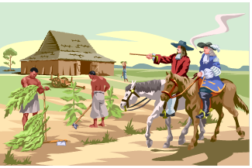
Virginia in the House of 1619 Virginia House of Burgesses
The first representative legislature anywhere in the English colonies in America was in Virginia. This was the House of Burgesses.
It first met on July 30, 1619, at a church in Jamestown.
Its first order of business was to set a minimum price for the sale of tobacco.

Slide 4
The Mayflower Compact 1620
When the Pilgrims came to America before they came ashore in Massachusetts they drew up the Mayflower Compact.
The male signers agreed to consult each other about the laws for the colony and promised to work together to make the colony succeed. This is a social contract of self-rule/ self- government.
Later when Plymouth colony grew too large for everyone to consult the settlers chose representatives to assembly and make laws.

Slide 5
1639 Fundamental Order of Connecticut
Thomas Hooker colonized Hartford, Connecticut
In this colony they adopted a plan of government called the Fundamental Orders of Connecticut. This was the first written constitution in American (new world)
Fundamental orders of Connecticut described the organization of representative government in detail.

Slide 6
The English Bill of Rights 1689
After King James II was removed from the throne by Parliament, William and Mary began their rule of England. In 1689, William and Mary signed the English Bill of Rights, which protected the rights of individuals in England as well as her colonies.
reaffirmed that anyone accused of a crime had the right to a trial by jury
it also outlawed cruel and unusual punishments
provided for the right to bear arms
ruler could not raise taxes or raise an army without the approval of Parliament.
These ideals are included in the Bill of Rights attached to the American Constitution. As English citizens, colonists were protected by the bill.

Slide 7
The Declaration of Independence 1776
The Declaration of Independence was drafted by Thomas Jefferson. The Continental Congress adopted the Declaration on July 4, 1776. The Declaration list the many grievances the colonists held against King George III, which included:
Imposing taxes on us without our consent
Government can’t take away “unalienable Rights (Life, Liberty, and the Pursuit of Happiness.)”
Declaring America free and independent states

Slide 8
The Articles of Confederation 1781
In May of 1776 the Continental Congress asked the states to organize their governments and each move quickly to adopt a state constitution. The Continental Congress also appointed a committee to draw up plans for a new central government to coordinate the War for Independence.
They wrote the Articles of Confederation, which created a league of independent states. Under the Articles of Congress had limited authority. Although the Articles had many weakness, Americans were able to win the war of Independence.

Slide 9
No President | Weak Central Government
Government can’t tax | Can’t regulate trade (Between states)
No court system | Government can’t raise an army
Changing Constitution Required Unanimous Approval | Passing laws required 9 of 13 states approval.

Slide 10
VIPs in developing American Government

Slide 11
John Locke “unlocks the key to your rights”
English Philosopher and Independent thinker
Believed and wrote about “natural rights” such as:
Life, Liberty and Property
Thomas Jefferson got is ideas from John Locke calling it unalienable rights such as:
Life, Liberty and Pursuit of Happiness

Slide 12
Baron Charles de Montesquieu
French Philosopher
Government powers should be separate but equal
Wrote The Spirit of the Laws in 1748
Proposed separating government into 3 branches so that power would not be concentrated in the hands of one person or group
His ideas inspired James Madison’s Federalist 47 and Federalist 51 papers

Slide 13
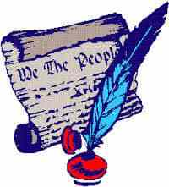
Thomas Hooker Fundamental Orders of Connecticut
Thomas Hooker created the Fundamental Orders of Connecticut which is the 1st written constitution and showed us how to outline our government
1st
Written
Constitution

Slide 14
William Blackstone English Expert on Rule of Law
British jurist (attorney) and philosopher
Final authority on the rule of law
Wrote The Commentaries on the Laws of England and Classic Commentaries on the Laws of England
Influenced US Founding Fathers James Madison and Thomas Jefferson

Slide 15
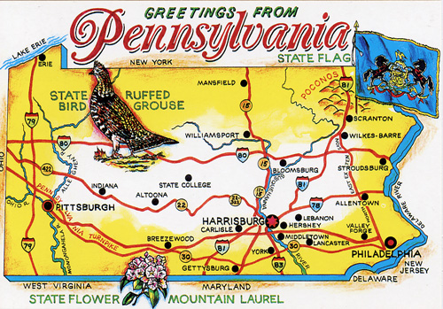
William Penn
Quaker that founded Pennsylvania
Believer in democracy and religious freedom
Conducted the Great Experiment by allowing religious freedom in his colony
democracy
Religious Freedom

