Slide 1
Spanish Colonial
1682-1821

Slide 2
Why Missions?
Populate Texas
Convert Native Americans to Catholicism
Establish claim to Texas (colonize)

Slide 3
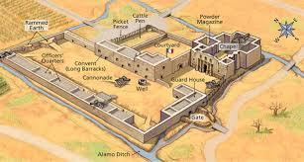
What are presidios?

Slide 4
In the mission
Presidio- protects the mission
Missions are located near water sources
Had many successes and failures

Slide 5
Mission Life
Prayer at dawn and religious instruction
Roll call
Breakfast
Work Assignments
Prayer and lunch
Siesta
Work Assignments
Worship service and religious instruction
Dinner
Supervised recreational activities
Sleep at sunset

