Slide 1
Unit 1: Being a Historian.. And Loving It!

Slide 2
Learning Targets
By Friday, you should know:
The difference between a primary and secondary source..
Why primary sources are better..
Some examples of primary sources..
What an “era” is and why we use it..

Slide 3
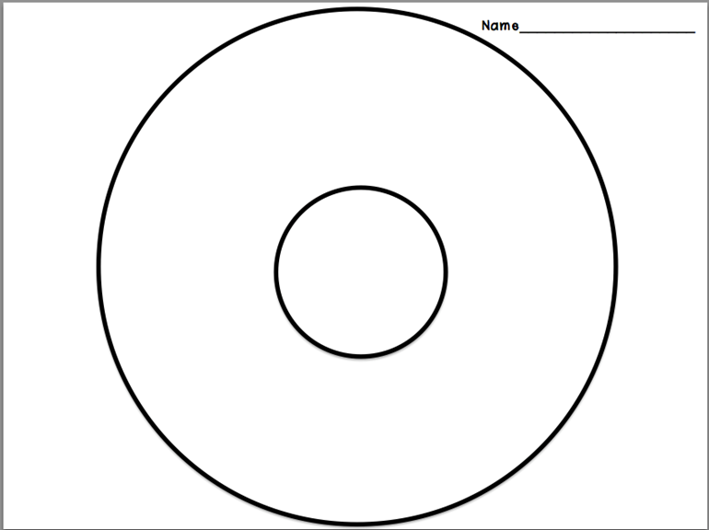
Word Dogg?
Pretend Drake came to town this summer and did a concert at Cowboys Stadium. You didn’t get to go, but you want to know all about it! Try to think of all the ways you could possibly get information about the concert and put it in your Drizzy Drake thinking map.

Slide 4
Vocab makes me smile :)
Unit 1 vocab

Slide 5
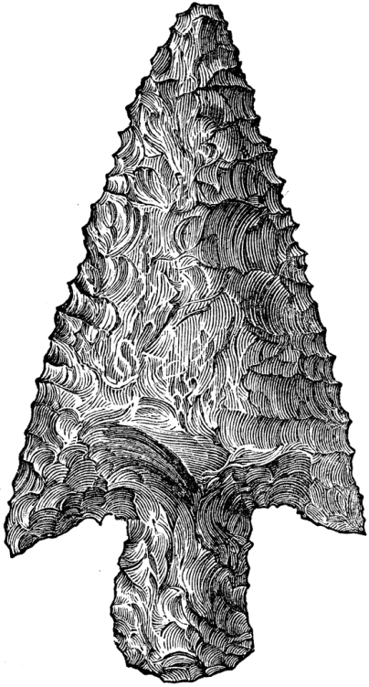
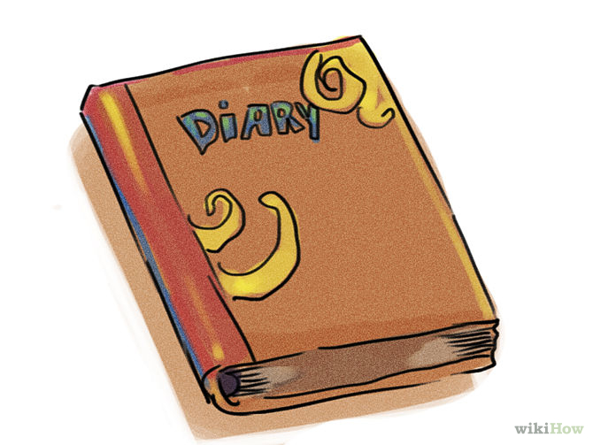
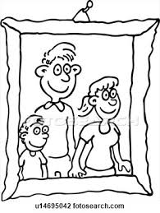
1. Primary Source
Provides direct or firsthand evidence about an event, object or person.

Slide 6
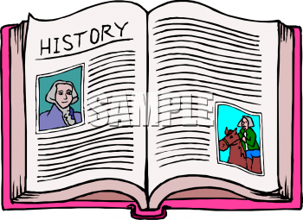
2. Secondary Source
Provides information about an event after the event has already passed.

Slide 7
3. Cause
A person or thing that makes an action happen

Slide 8
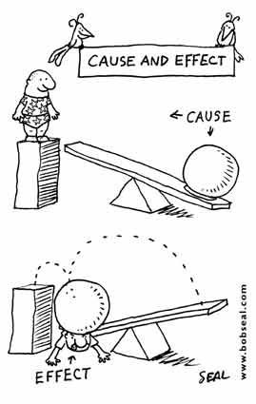
4. Effect
A change that is the result of an action or cause

Slide 9
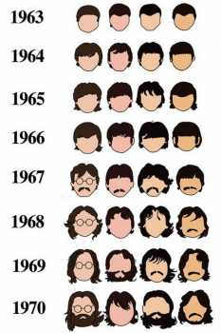
5. Absolute Chronology
The time in which an event occurred independent of all other events.
Timeline of the Beatles hairstyles

Slide 10
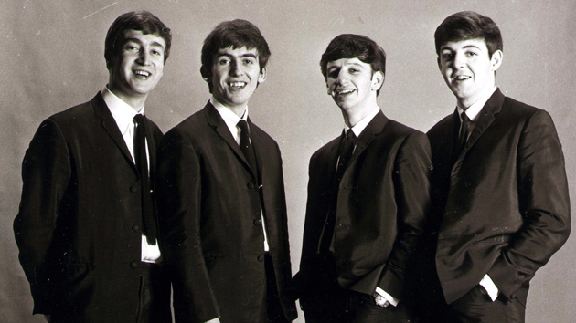

Slide 11
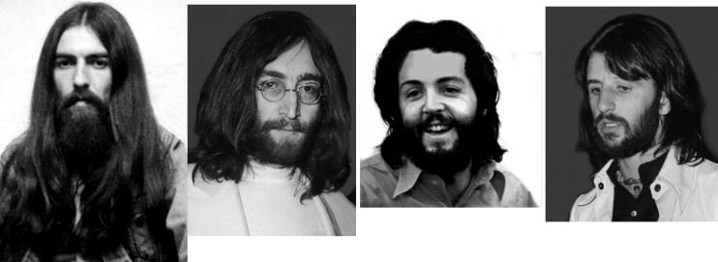

Slide 12
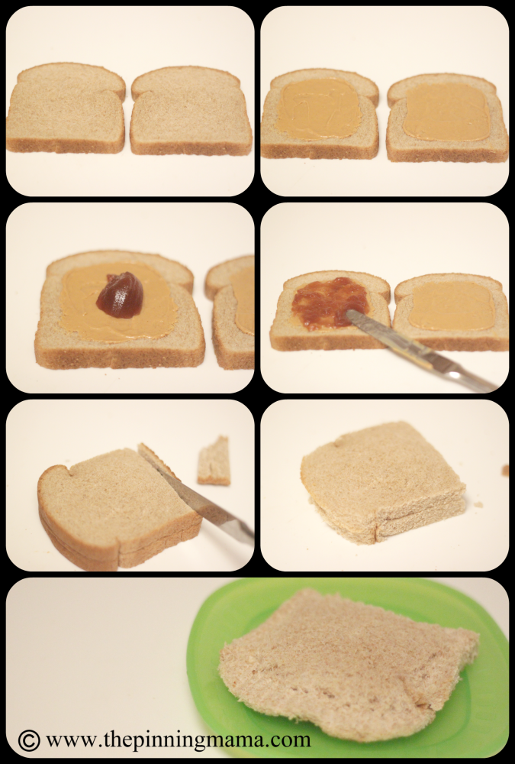
6. Relative Chronology
The order in which events occurred compared to other events.

Slide 13
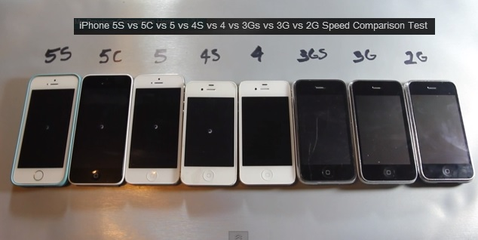
7. Era
A period of time in which similar events occurred.

Slide 14
Do this warm up question and then just chill for a minute..
A primary source is a source of information that comes _______.
A. From a history book
B. From someone who is an expert on the subject or event
C. Directly from the event
D. Directly from a reliable source

Slide 15
Words of wisdom from Coach Chavira:
Different sources of information offer us a unique look into the lives of people from a particular era. Since we are unable to be there ourselves, it is important that the information we get about the past is as accurate as possible. Primary sources give us the best chance of obtaining accurate information by avoiding exaggeration, bias and distortion.

Slide 16
Types of Primary Sources
There’s 6 types of Primary Sources. It’s important that you are able to recognize the differences between Primary and Secondary!

Slide 17
Printed Publications
Printed publications include things like books, newspapers and magazines

Slide 18
Songs and Poems
Songs and Poems express thoughts and beliefs

Slide 19
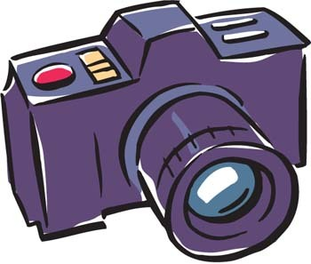
Visual Materials
Visual Materials include things like artwork, pictures and videos

Slide 20
Oral Histories
Oral history are things like interviews or first-hand accounts from people who were there

Slide 21
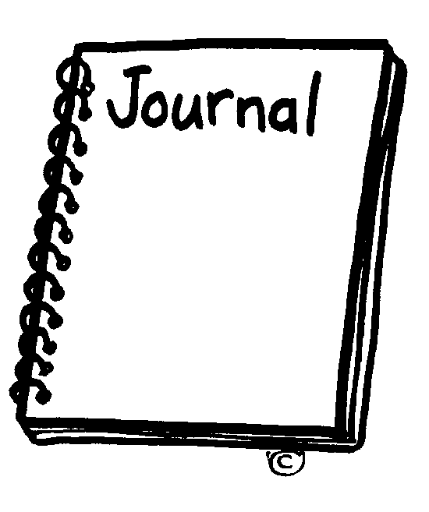
Personal Records
Personal records include things like diaries, journals and letters

Slide 22
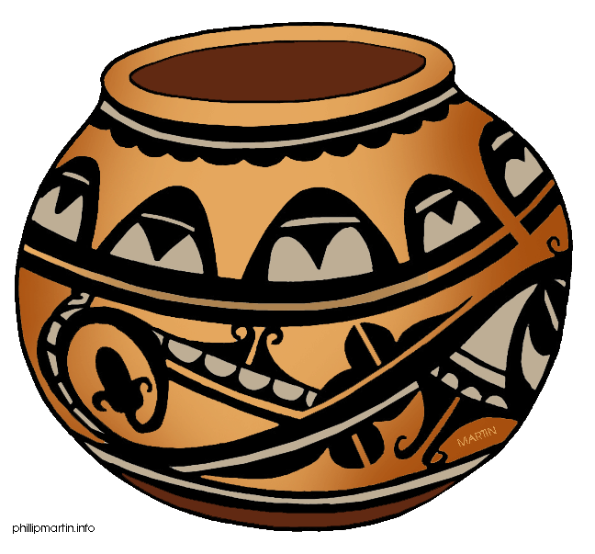
Artifacts
Artifacts include things like tools and pottery

Slide 23
Can you tell the difference activity
Work on your own for the next 5 minutes on the “Can you tell the difference?” activity. If you are working quietly, then I’ll allow you to work in partners for 5 minutes. We will then go over it together. I’ll pull popsicle sticks for answers so be prepared!

Slide 24
Eras and Chronology
An era is a period of time in which similar events occur.
What were some of the examples we thought of for eras that relate to you?

Slide 25
Think of some eras in your own life
Take the next 3 minutes and try to think of some periods of time in your life that are grouped together by similar events. Some of them are still happening now! (ex: middle school era)

Slide 26
Chronology
Remember, chronology is how we keep things in order. There are 2 basic kinds of chronology.

Slide 27
Absolute Chronology
When things are absolute, they do not change. Dates are absolute, so absolute chronology is kept in order by specific points in time, or dates.

Slide 28
Relative Chronology
When things are relative, they depend on one another. Events are relative so relative chronology is kept by the order in which events happened.

Slide 29
It’s all relative, right?
Answer the 5 questions about absolute and relative chronology. Try to think about if those events would need to be ordered by date or by the way the events fit together with each other!

Slide 30
Timeline Activity
Flip to the next page and find the 2 timelines labeled relative and absolute chronology. You will be adding events to the timeline from your own life so I can get to know you better.
Relative will be ordered by the way events happened.
Absolute will be ordered by date. (If you don’t know the exact date, then estimate.)

Slide 31
Let’s Check Our Learning Targets!
Let’s check with our neighbors and see if we know our stuff

Slide 32
What is the difference between a primary and secondary source?
If you are not sure, you have 2 minutes to talk to a neighbor to get up to speed! I’m going to pull a popsicle stick for an answer so you better know it or find someone who does!

Slide 33
Why are primary sources better that secondary sources?
If you are not sure, you have 2 minutes to talk to a neighbor to get up to speed! I’m going to pull a popsicle stick for an answer so you better know it or find someone who does!

Slide 34
What are some examples of primary sources?
If you are not sure, you have 2 minutes to talk to a neighbor to get up to speed! I’m going to pull a popsicle stick for an answer so you better know it or find someone who does!

Slide 35
Why do we group time into eras?
If you are not sure, you have 2 minutes to talk to a neighbor to get up to speed! I’m going to pull a popsicle stick for an answer so you better know it or find someone who does!

Slide 36
You survived!
If you know all that stuff, then you survived and thrived during your first week of Texas History!
Congratulations!
If there’s some you’re not sure about, feel free to come ask me!

