Slide 1
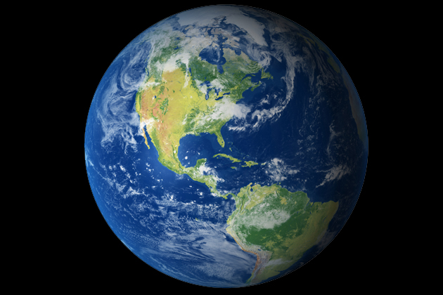
Unit 2: Being a Geographer

Slide 2
Learning Targets
By the end of this unit, you should know:
The four major regions of Texas and what they are like..
Some of the major cities, rivers, and natural resources of Texas..
How the physical features of Texas influence its development and history..
How the climate, weather, and landforms affect the distribution of population in Texas..

Slide 3
Texas and its Regions
Texas is made up of 4 different regions.
Each one has different characteristics.
Before we study the geography of Texas, let’s figure out where those regions are and what they are called.

Slide 4
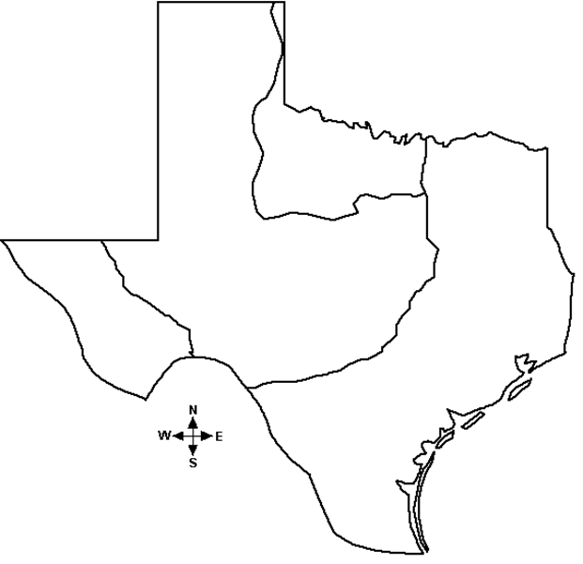
Texas and its Regions
Take the next 5 minutes to color and label the 4 regions of Texas.
Use page 49 in the book

Slide 5
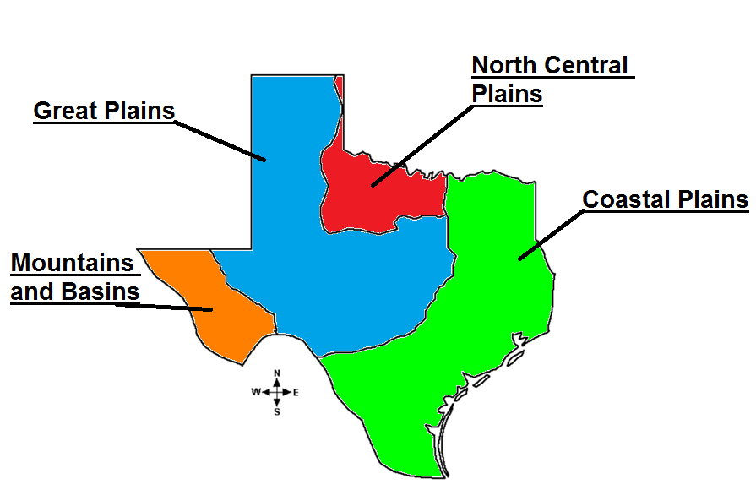

Slide 6






Slide 7
1. Region
An area that is unified by one or more common characteristics

Slide 8
2. Physical Geography
The way the land is formed in a certain region

Slide 9
3. Human Geography
The interaction between humans and their environment

Slide 10
4. Climate
The weather conditions in an area over a long period of time

Slide 11
5. Landform
A natural feature of the earth's surface

Slide 12
6. Technology
The use of science to improve the lives of humans

Slide 13
7. Modify
Making changes to something to improve it

Slide 14
8. Cultural Diffusion
The spreading out of a culture to those around it

Slide 15

Just for Fun
http://www.youtube.com/watch?v=afcudstM9zA

Slide 16
End of Day

Slide 17
Warm-up for the day
Read the words of wisdom from Coach Chavira on your packet and be ready to talk about them!
  (I’ll be pulling popsicle sticks, so you better be ready)

Slide 18
Ask a Neighbor
Now that you have put a little thought into the words of wisdom, turn to a neighbor to see what they think.
The write down what you came up with between you and your neighbor in 2-3 complete sentences.

Slide 19
Words of Wisdom from Coach Chavira
All human geography is developed from physical geography. Our houses, skyscrapers, streets, cellphones, computers, cars, and anything else we can think of was made only from things that came from the Earth. That is why it is so important to protect the resources we have.

Slide 20
Quick Matching Review
Let’s quickly review the vocab from yesterday. You have 5 minutes to complete the quick matching review. Try to do it from memory and context clues before looking up the answers.

Slide 21
1. E
2. C
3. A
4. D
5. B
6. G
7. H
8. F

Slide 22
Region Project
You will now be assigned 1 of the 4 regions of Texas. Your group will be responsible for preparing a poster board as well as a short presentation over your assigned region.

Slide 23
Grading Scale
Here’s how you will be graded:
Criteria | Percentage of Score
Effort throughout the project | 25%
Poster content and neatness | 25%
Presentation clarity and information | 25%
Content | 25%

Slide 24
Presentation/Poster Checklist
The name of your region
A picture of Texas highlighting your region
The physical geography of your region
Some of the major cities of your region
Some of the natural resources of your region
The climate of your region
3 interesting facts about your region

Slide 25
End of Day

Slide 26
Welcome to Thursday!
We will continue working on our projects today. Remember to look at your checklist or ask me if you have questions!
We will be presenting tomorrow!

Slide 27
Project Checklist
My poster is completed and ready to present!
My group has organized our presentation and is ready to present!
My time machine paragraph has been completed with my best effort!
The questions about my region on the “4 Regions of Texas” page have been completed!
I am familiar enough with my region to answer questions about it when Coach Morgan asks me!

Slide 28
End of Day

Slide 29
Presentations
For your warm-up, get ready to present. You should be pretty close to ready, but you will have 10 minutes to gather your group and your thoughts!

Slide 30
Grading Scale
Here’s how you will be graded
Criteria | Percentage of Score
Effort throughout the project | 25%
Poster content and neatness | 25%
Presentation clarity and information | 25%
Content | 25%

Slide 31


End of Day
Have a great weekend! Hope it’s filled with Netflix and Call of Duty!

Slide 32
Warm-up
Use the situation from your time machine writing. You are still stuck in the past. However, this time you have the option to move to any of the 4 regions to live. In 1-2 complete sentences, tell me which one you would choose and why.

Slide 33

Mondays are so boss

Slide 34
Test Friday!!
This is your official warning that you will be having a test this Friday. It will cover everything we have done this year up to this point.
(If you’ve been paying attention in class and doing your work then don’t panic)
It will be a major grade

Slide 35
So what do the regions have to do with the people of Texas?
Today were going to talk about how the physical geography and resources of a region affect the people living there.
  Population Distribution

Slide 36
Think..
Try to think on your own of some things that could effect why people would move to a certain place in the old days.

Slide 37
Pair..
Now, talk with a neighbor and see if you can gather some more ideas from their perspective.

Slide 38
Share..
Make a list in the space provided of at least 3 things that could affect why someone would live in a certain place.

Slide 39


Slide 40


Slide 41
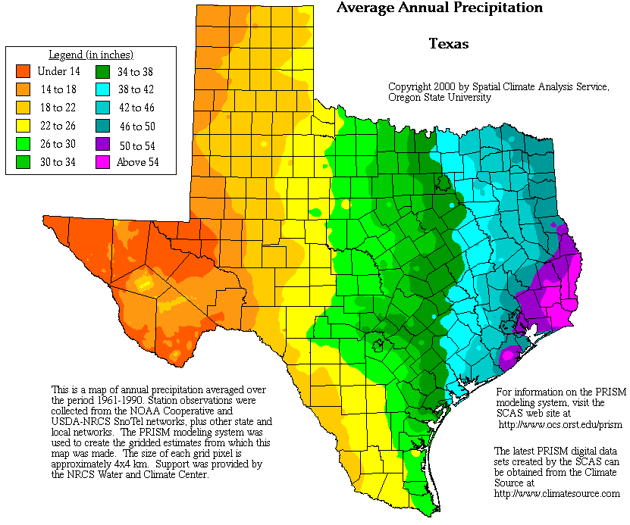

Slide 42
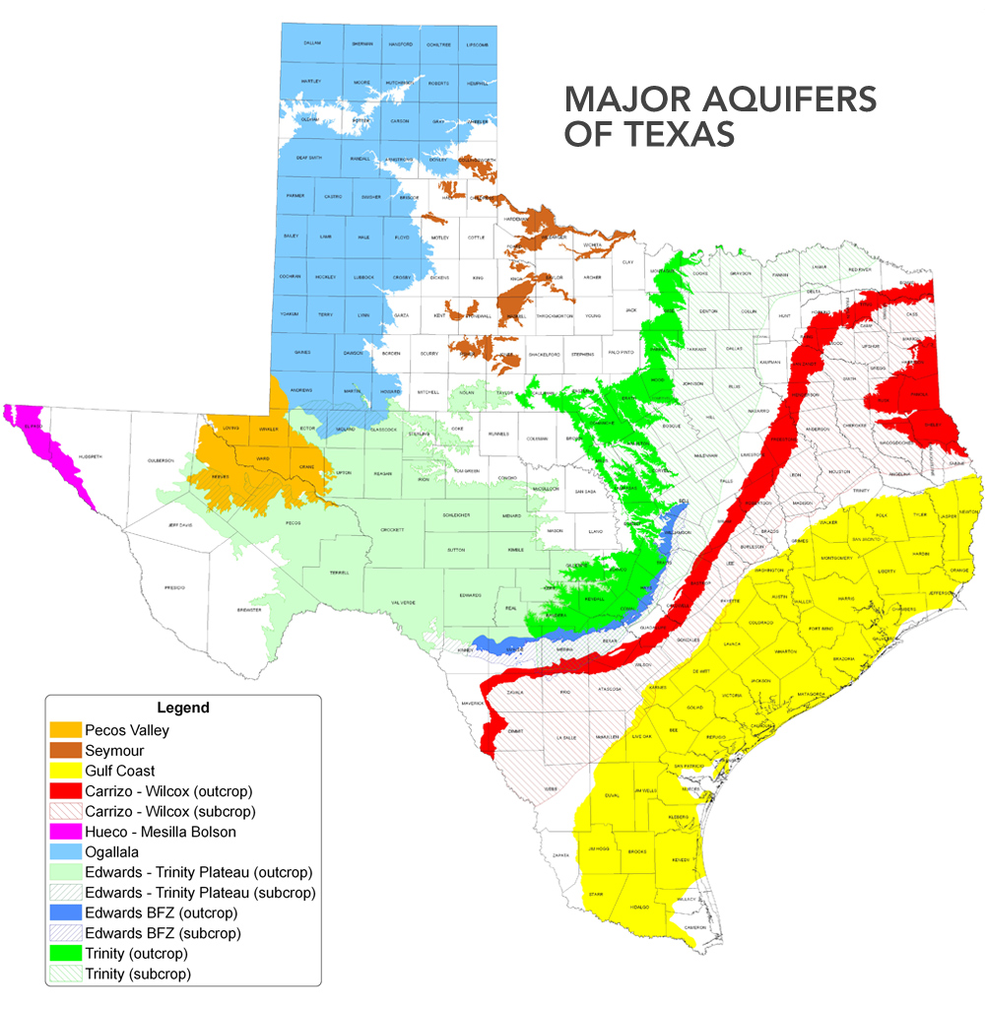

Slide 43
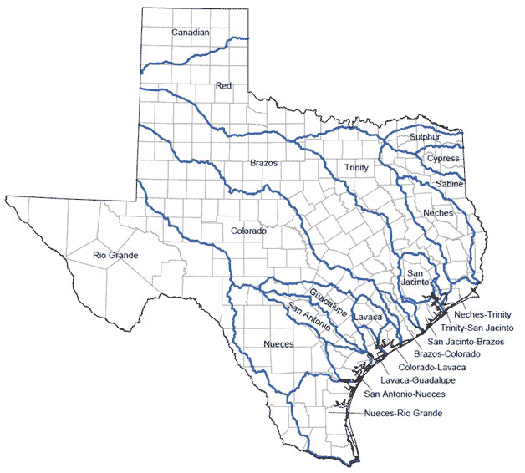

Slide 44
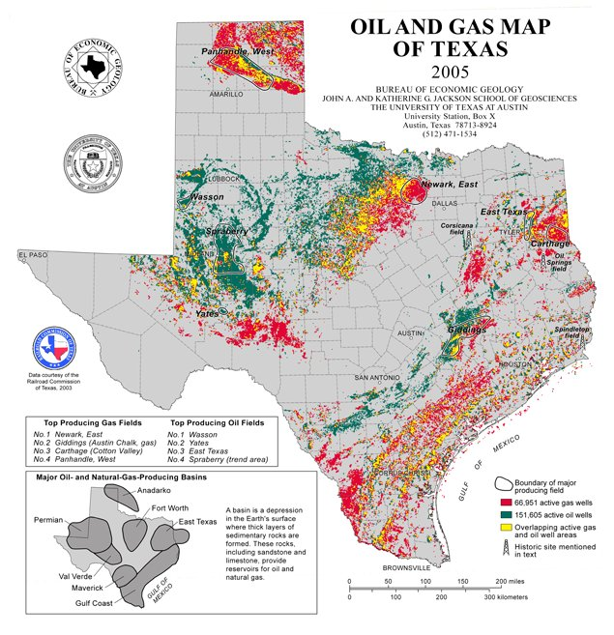

Slide 45
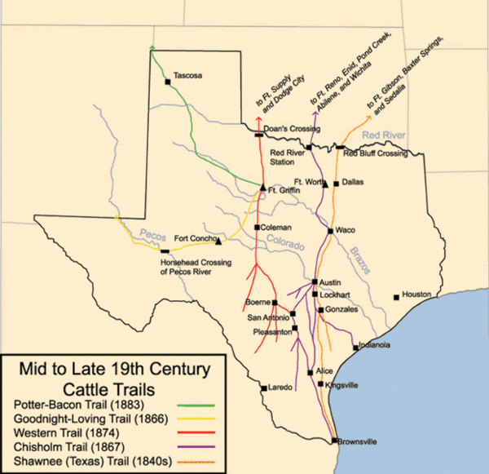

Slide 46
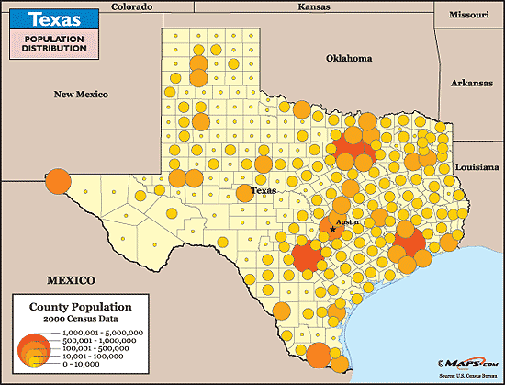

Slide 47
What did you learn?
Tell me one thing you learned from the maps of Texas

Slide 48
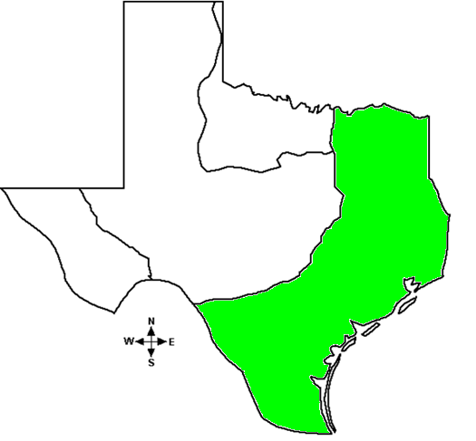
Coastal Plains

Slide 49
Coastal Plains
Largest region in Texas
About 2 out of every 3 Texans live in the Coastal Plains
The most important oil boom in Texas history happened here
The first explorers came to the Coastal Plains
The Northern part of the Coastal Plains has the densest forests in Texas
The Coastal Plains are home to Houston, Austin, Corpus Christi, Galveston, Waco, Dallas, and many more

Slide 50
Coastal Plains Sub-regions
Flip to page 50 in the textbook and check out the sub-regions of the Coastal Plains.
The regions of Texas are still so big that we must break them down even further into sub-regions to classify them.

Slide 51
North Central Plains

Slide 52
North Central Plains
The North Central Plains of the United States actually start in Canada and extend down to Texas
The rivers traveling downhill to the Gulf of Mexico have carved out hills here
We live here!
The North Central Plains are home to Fort Worth, Arlington, Denton, and many more

Slide 53
North Central Plains Sub-regions
Flip to page 57 in the textbook and check out the sub-regions of the North Central Plains

Slide 54
Great Plains

Slide 55
Great Plains
The Great Plains also begin in Canada
They are often referred to as a “sea of grass”
Irrigation has helped people be able to farm the land in the Great Plains
The Great Plains often experience drought
Palo Duro Canyon is the deepest canyon in Texas
The Great Plains are home to Amarillo, Lubbock, Midland, Odessa, and many more

Slide 56
Great Plains Sub-regions
Flip to page 62 in your book and check out the sub-regions of the Great Plains

Slide 57
Mountains and Basins

Slide 58
Mountains and Basins
The Mountains and Basins are on the outskirts of the Rocky Mountains
It is the driest region in Texas
It is also the smallest region of Texas and has no sub-regions
The Mountains and Basins include El Paso, some small cities, and not much else

Slide 59
Mountains and Basins Sub-regions
There are none! Too small

Slide 60
Ticket out the door
Look back to your warm-up for today. You need to decide if you would like to keep your answer the same or change it to something else.
You need to tell me if you decided to change your answer or not, and why!
(1-2 complete sentences)

Slide 61


Slide 62
End of Day

Slide 63
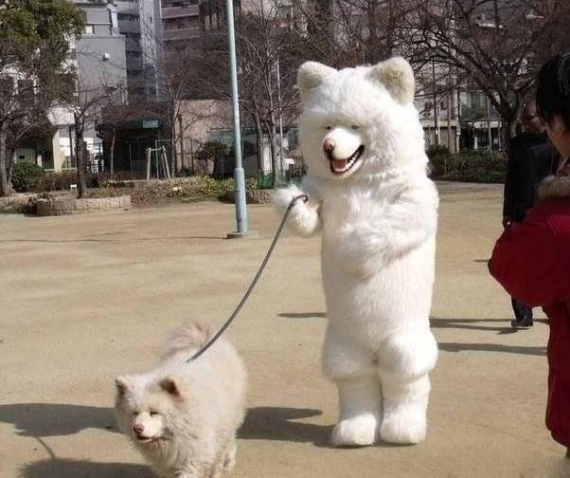
Welcome to Tuesday, here’s this guy..

Slide 64

Expo Maps
You will need 1 map between 2 partners
You will each need an expo marker
Keep the lids on the markers when you’re not using them!

Slide 65
Expo Maps
You will be locating each of the items listed in your packet
You need to mark each one as directed and then check that item off your list
I will come around and check before you do any erasing!
You have 20 minutes to complete the activity

Slide 66
Google Earth
We are going to spend some time looking at Google Earth to try and get some perspective on the way Texas looks from above
https://www.google.com/maps/@29.2346276,-97.818413,1507947m/data=!3m1!1e3

Slide 67
Things to check out on Google Earth
Texas from above
  Color of land
Fort Worth
  Saginaw
  Highland
  Stockyards
El Paso
  Desert
Houston
  Downtown
San Antonio
  Alamo
  River Walk
Austin
  Capital Building
Beaumont
  Spindletop
  Forest

Slide 68
Ticket out the door
In 1-2 sentences, tell me one place in Texas you would like to visit and why
In 1-2 sentences, tell me one thing you learned today

Slide 69
End of Day

Slide 70
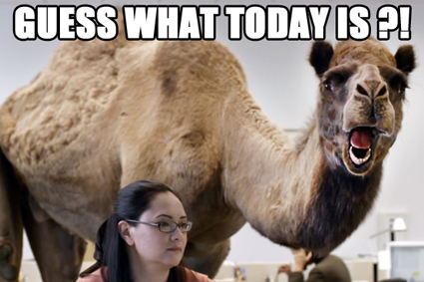

Slide 71

Double Bubble Time
Use the double bubble thinking map template to compare and contrast the Mountain and Basins region of Texas with the Coastal Plains region of Texas

Slide 72
Sample Test Questions
In your packet you have some sample test questions.
These questions are tough, but are the kind that will appear on your benchmark and semester exams so we need to start practicing now!
Take a few minutes to answer them on your own and then we will go over them together.
You need to do it! I will draw popsicle sticks for answers!

Slide 74
Question 1 answer
A

Slide 76
Question 2 answer
B

Slide 78
Question 3 answer
C

Slide 80
Question 4 answer
A

Slide 82
Question 5 answer
B

Slide 84
Question 6 answer
B

Slide 86
Create a Test
In partners, you will be creating a short test.
Your test will have 6 multiple choice questions over the material we have studied in this unit.
You may use information from your packet and from the textbook, pages 48-69
  The questions must be answerable! Don’t make them too hard or too easy!
Create your test on the template in your packet
  Both partners must write it neatly in their own packet!!!

Slide 87
End of Day
We will finish making our test tomorrow!
In the meantime, stay golden Ponyboy

Slide 88
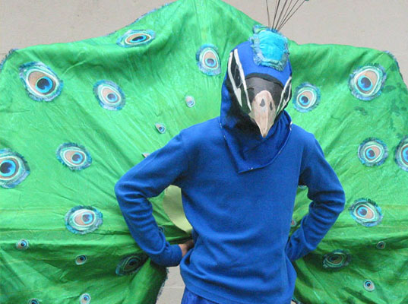
Hooray for Thursday!
Coach Peacock

Slide 89
Time to finish creating our tests!
You will have about 15 minutes to finish creating your test.
Remember, it is for a grade so you need to do your best on it!

Slide 90
Create a Test
In partners, you will be creating a short test.
Your test will have 6 multiple choice questions over the material we have studied in this unit.
You may use information from your packet and from the textbook, pages 48-69
  The questions must be answerable! Don’t make them too hard or too easy!
Create your test on the template in your packet
  Both partners must write it neatly in their own packet!!!

Slide 91
Test Review
Once you complete your “create a test” activity, you need to begin working on your test review.
You may work with the same partner to complete the review questions in your packet.
The information these questions cover will show up on your test!

Slide 92
Any Questions??
Before we leave, were there any questions over the review that you need answered before the test?

Slide 93
End of Day

Slide 94


Slide 95
Get yo review on!
Game face time..
You will have 10 minutes to review with a neighbor over your review sheet. If you choose to waste that time, we will start the test sooner!

Slide 96

Test time!

Slide 97
Let’s go through our learning targets
If you feel like you totally understand a concept, put a checkmark next to it as we go.
If you don’t understand it, leave it unchecked so I will know how to do better next time!

Slide 98
Learning Target 1
I know the four major regions of Texas and what they are like..

Slide 99
Learning Target 2
I know some of the major cities, rivers, and natural resources of Texas..

Slide 100
Learning Target 3
I know how the physical features of Texas influence its development and history..

Slide 101
Learning Target 4
I know how the climate, weather, and landforms affect the distribution of population in Texas..

Slide 102
Prize Drawings!
If your class has been good, then it’s time for prize drawings!! :)

Slide 103
End of Day, End of Unit
Congrats on surviving another week of Texas History and I promise next week will get more interesting!

